Slide 1
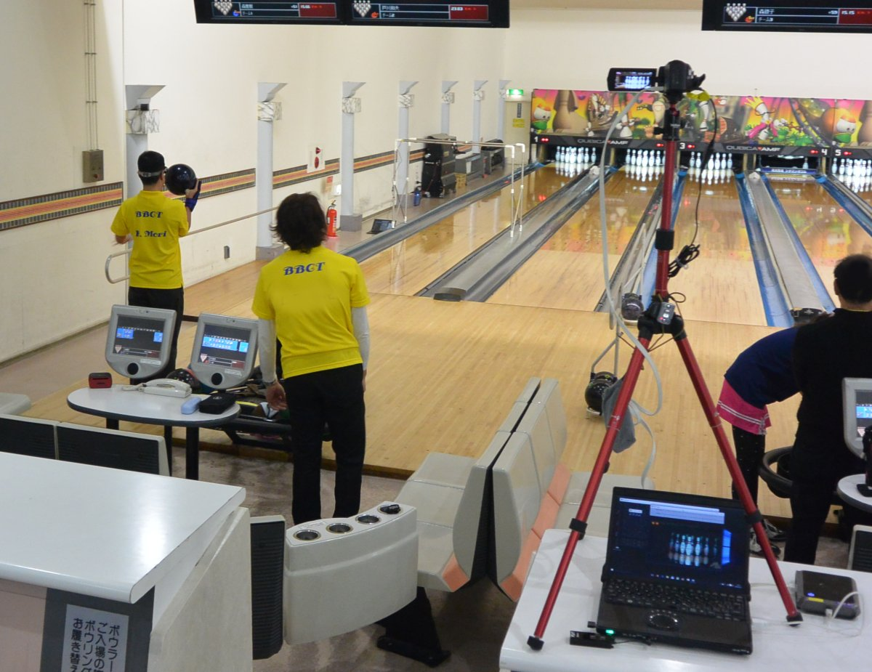
Ball Course Detection Function for the Blind Bowling Support System Using a Depth Sensor
Makoto KOBAYASHI
Tsukuba University of Technology

Slide 2
Video

Slide 3
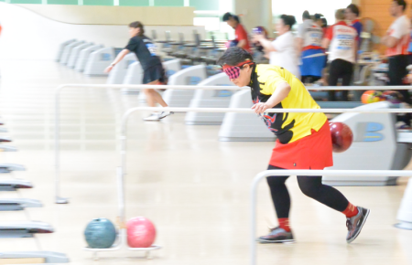
What is Blind Bowling?
Ordinary equipment(lane, ball), usual rules
Conditions in B1=totally blind class : (B2 and B3 is class for VI)
Wear EYE MASK
Use GUIDE RAIL
Use INFO by SIGHTED ASSISTANT

Slide 4
Info by Assistant & Research Objective
Assistant informs:
How many pins are remaining now.
Where the ball hits.
What the ball course was (number of floor board in the arrow mark area).
However, Blind players want to play w/o help !
→Develop support system replacing assistant
→Automatic
counting pins
→Ball course
detection

Slide 5
Info by Assistant & Research Objective
Assistant informs:
How many pins are remaining now.
Where the ball hits.
What the ball course was (number of floor board in the arrow mark area).
However, Blind players want to play w/o help !
→Develop support system replacing assistant
→Automatic
counting pins
→Ball course
detection

Slide 6
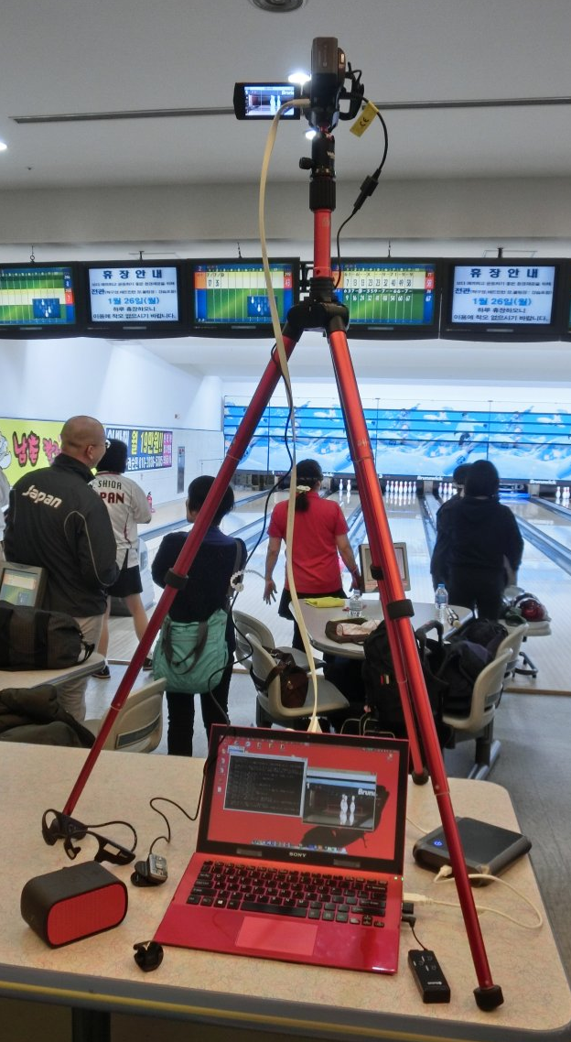
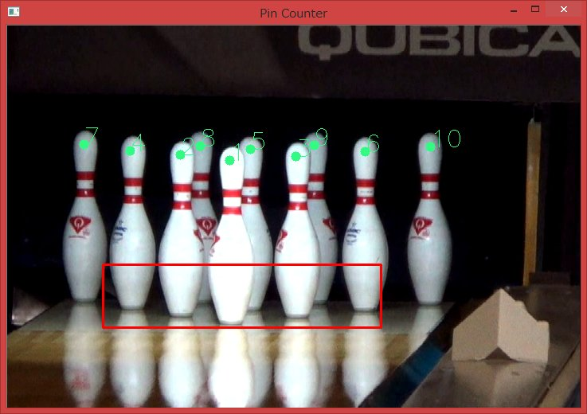
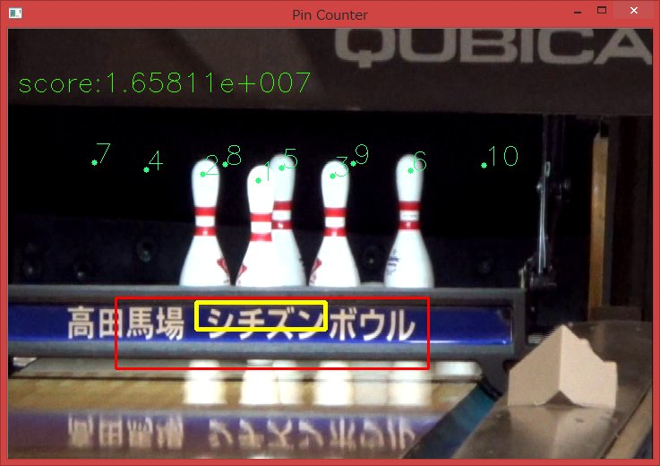
System for Automatic Counting Pins
Using simple image processing
Video Camera
Tripod
HDMI to USB Converter
Computer
Remaining pins are, ….
Bluetooth Transmitter
Bluetooth Speaker

Slide 7
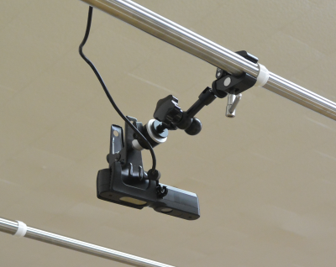
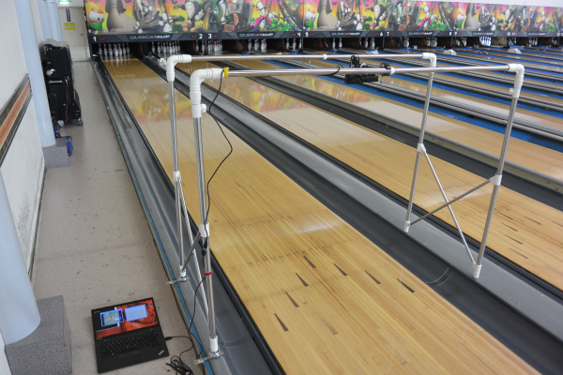
System for Ball Course Detection
Depth sensor bridges over the lane
Xtion Pro Live (ASUS)

Slide 8
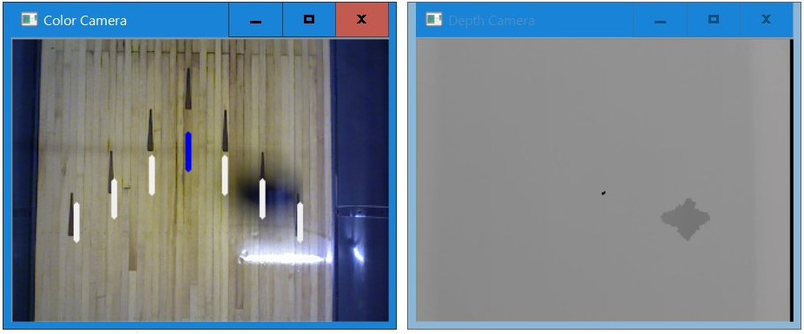
System for Ball Course Detection
Scan the center line
Detect nearest point = Ball course

Slide 9
Tested by Mr.MORI, Winner in IBSA2015
3days, 3-4games/day
→70-80% succeeded, missed when the ball went fast
Ball course detection system
→Worked perfectly!
Remaining pins counting system

Slide 10
Improvement
Scanning lines are increased(1 → 5).
It works properly for recorded data.
Real testing is plan to be conducted this summer.

Slide 11
Summary
Developed a Blind Bowling Support System
“automatic pin counting” using image processing
“ball course detection” using depth sensor
Results of Test
Pin counting system works perfectly.
Ball course detector needs to be tested again, but theoretically works well.

Slide 12
Summary+
STRONGLY would like to remark that:
This support system is not only for the players but also for BLIND-AUDIENCEs.
They can enjoy “watch”ing the bowling with these info by the BT speaker(s).
Assistant doesn’t tell info to the audience in usual!

