Slide 1
A Study of Speech Vs. Braille and Large Print of Math Expressions
Neil Soiffer
Senior Scientist at Large

Slide 2
Can Math-to-Speech be Useful?
Pythagorean theorem:
a squared plus b squared equals c squared
Law of Sines:
sin A over a, equals, sin B over b, equals, sin C over c
Heron’s formula
A equals, one fourth times, the square root of, open paren a plus b plus c close paren, times, open paren negative a plus b plus c close paren, times, open paren a minus b plus c close paren, times, open paren a plus b minus c close paren

Slide 3
Three Triangle Formulas (Revealed)
Pythagorean theorem:
Law of Sines:
Heron’s formula:

Slide 4
Navigation Features
Moving/Zooming:
Descriptions/Overviews
Place markers
Where am I

Slide 5
Navigation Modes
Character/Word
Simple
Enhanced

Slide 6
Speech Research Study
ClearSpeak
Prosody
Navigation
Teacher authoring
Pilot

Slide 7
Research Results
20 Blind/Low vision students

Slide 8
Ratings of Navigation Features
Using feature made spoken math... | Much easier | Somewhat easier | Slightly easier | No easier
Arrow keys | 14 | 4 | 2 | 0
Zoom in/out | 14 | 5 | 0 | 1
Switch navigation modes | 13 | 4 | 2 | 1
Place markers | 7 | 4 | 6 | 3
Where-am-I | 3 | 5 | 2 | 9
Describe | 2 | 5 | 1 | 12
Notes:
No surprise: Arrow keys and Zooming in and out is liked
Surprise? Most students likes switching navigation modes
Less liked: placemarkers
Least liked: Where-am-I and Describe

Slide 9
Ratings of Navigation Features
Much easier/Somewhat easier:
Moving, Zooming
Switching navigation modes
50/50
Placemarkers
Slightly easier/No easier
Where-am-I, Describe

Slide 10
Final Pilot
21 students, 17 participated in Nav study
Each Student was given 2 documents
Word Doc + NVDA + MathPlayer
Braille, Regular print for CCTV, or Large Print
Paired Documents w/16 questions each
Net Scoring:
-1 (spoken)
0 (spoken)
1 (spoken)
Average: 0.125, Std Dev: 2.73

Slide 11
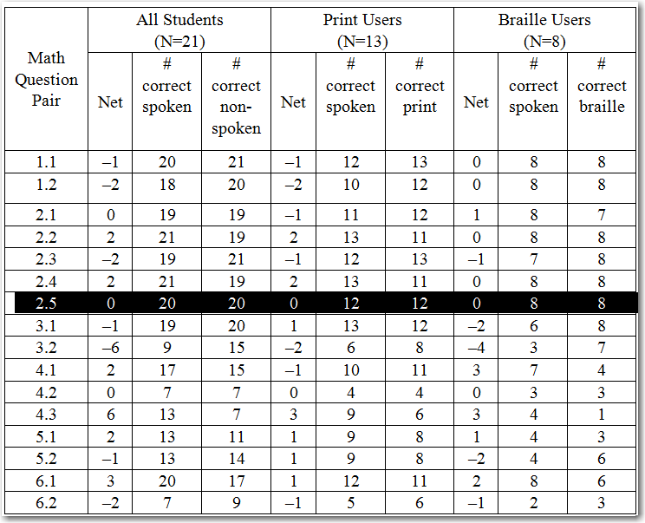
Performance for each Question
Very similar results except for:
3.2: Simplify the expression
4.3: What is the value of the expression

Slide 12
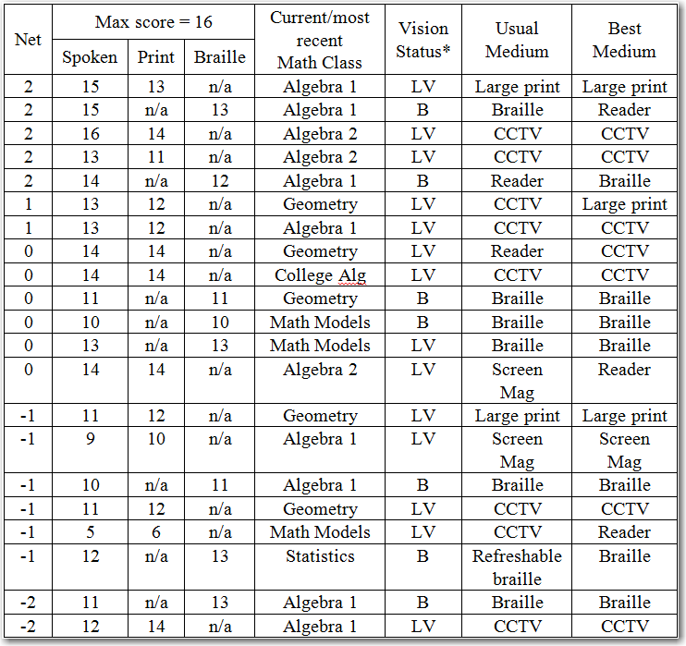
Performance for each Student
Max difference between formats: 2
Small preference for their original format
Scores slightly higher for speech
Time spent/format didn’t correlate w/performance
Understanding: “somewhat easy” vs “very easy”

Slide 13
Summary & Open Questions
Speech + Navigation == Braille/Large Print
Not a replacement, but another access mode
Open Questions
Can Describe/Overview be made useful?
Navigation Integration w/editing?

Slide 14
Acknowledgements
Lois Frankel and Beth Brownstein at ETS
Steve Noble
Sina Bahram
The research reported here was supported by the Institute of Education Sciences, U.S. Department of Education, through Grant R324A110355 to the Educational Testing Service. The opinions expressed are those of the authors and do not represent views of the Institute or the U.S. Department of Education.

Slide 15
More Info
Read the paper
www.clearspeak.org
MathPlayer supports:
English, Dutch, German, Italian
Chinese, Czech, Danish, French, Finnish, Greek, Icelandic, Japanese, Norwegian, Spanish, Swedish

