Slide 1
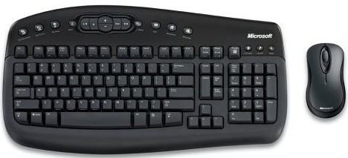
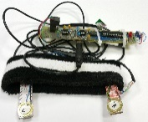
Replacement of the Standard Computer Keyboard and Mouse by Eye Blinks
Muhammad Bilal Saif
Torsten Felzer
Institute for Mechatronic Systems,
Technische Universität Darmstadt, Germany.

Slide 2
Presentation Layout
Motivation
Sytem overview
Sensor
Different types of sensors in Literature
Placement of Sensor
Headband & Associated Electronics
VirtualKeypad (VK) & Detection Algorithm
Results and Comparison with other Publications
Summary

Slide 3
Motivation
Motivation of this work is to
fascilitate the humans who are unable to use the conventional keyboard & the mouse due to nerve or muscular damage.
This damage can be due to some accident or disease (e.g. Muscular dystrophy, Friedreich ataxia etc.)
Notes:
To reduce the deficulties faced by physically disabled persons in using computer.

Slide 4
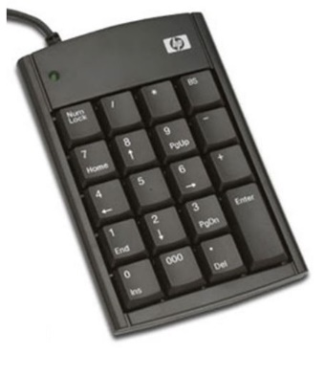
System Overview
Softwares
Readout Circuit
First Software
Processes raw data from the sensors
Determine the type of signal i.e.
Left eye blink
Right eye blink
Both eyes closed
USB
VirtualKeypad (VK)
X
Second Software
Generate text (keyboard function)
Selecting on-screen objects (mouse function)
OSDS
© Fotosearch.com
Felzer T., MacKenzie I.S., and Rinderknecht S.: OnScreenDualScribe: A Computer Operation Tool for Users with a Neuromuscular Disease. In: Proc. UAHCI/HCII '13, pp. 474–483. Springer-Verlag Berlin Heidelberg (2013)

Slide 5
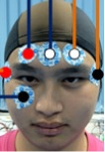
Types of sensors in Literature
Electrooculography (EOG)
Camera
Piezoelectric sensors
Published in [1]
Published in [2]
Published in [3]
[1] Tangsuksant W., Aekmunkhongpaisal C., Cambua P., Charoenpong T. and Chanwimalueang T.: Directional Eye Movement Detection System for Virtual keyboard Controller. In: Proc BMEiCON'12. IEEE, pp 1-5 (2012)
[2] Królak A. and Strumiłło P.: Eye-blink detection system for human–computer interaction. In: Universal Access in the Information Society, Volume 11, Issue 4, pp 409-419 (2012)
[3] Felzer T. and Nordmann R.: Using Intentional Muscle Contractions as Input Signals for Various Hands-free Control Applications. In: Proc iCREATe '08, pp 87-91
Notes:
All systems have two things in common. They have a hardware and software to process this information
EOG:
Needs several facial sensors which are hard for disabled person to place
Camera:
Easy for user but requires high computational power
Piezoelectric sensors
Reduced number of sensors and reduced computational load

Slide 6
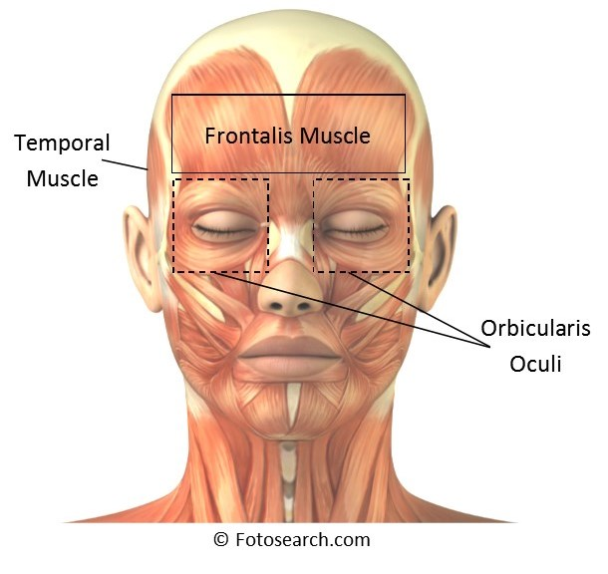
Sensor Placement
Physiology and anatomy of the facial muscles have been studied to determine the best site for sensor placement. Criteria for sensor site is
It should be easily accesible
Interference between the sensors should be minimum so that system electronics can easily detect the signal type that can be
Left eye blink
Right eye blink
Both eyes closed

Slide 7
Sensors Placement -- Forehead
Pros
Easily accessible
Cons
Difficult to determine the signal type due to interference
Forehead
© Fotosearch.com

Slide 8
Sensors Placement (CONTD.)
Pros
Accurate detection, due to less interference
Cons
Discomfortable for the user
© Fotosearch.com

Slide 9
Sensors Placement (CONTD.)
Pros
Comfortable for the user
Accurate user signal detection
Can also be actuated by jaw bones
Cons
Attachment to headband is deficult
© Fotosearch.com

Slide 10
Head band and electronics
Electronics:
Piezo-sensor biasing circuit
Analog amplifier
Microcontroller
Wired/wireless (RFM73) connection to the headband
Battery (LIPO)
Battery charge controller
Wired connection to the computer

Slide 11
VirtualKeypad -- VK
This software is responsible for
processing the raw data to determine the type of eye blink
Depending upon the time of blink, it has to generate a virtual keycode for the OSDS.
For blink type determination, following two detection algorithms have been tested,
Derivation based
Envelop based
Notes:
The aim is to find the accurate and least computational extensive algorithm.

Slide 12
Detection Algorithms -- Derivation Based
Steps
Take Derivative to get rid of constant value
Take the absolute value to get rid of negative spikes
Add all the spikes in the window
Compare the sums

Slide 13
Detection Algorithm -- Envelop Based
Left
Both
Right
Steps
When an envelop has been crossed initiate the window
Take the maximum and minimum of the readings in the window
Check if minimum value has crossed the lower envelop or maximum value has crossed the upper envelop
Saif M. B., Neubert M., Spengler S., Beckerle P., Felzer T., and Rinderknecht S.: Multi-Signal Virtual Keyboard (MSVK) Use of Various Sensors to Replace the Standard Keyboard – First Steps. In: Proc MIDI'14 (2014)

Slide 14
Virtual Keypad
Detection Envelop fine tuning
Calibration
On Screen Keypad
Scanning Scheme

Slide 15
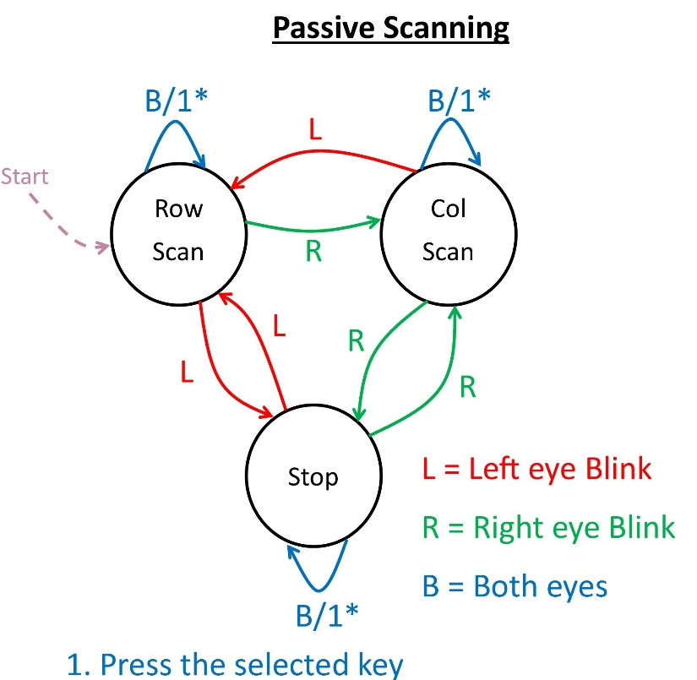
VirtualKeypad (VK)

Slide 16
Test Results
System is tested by 5 able-bodied and 1 disable person
All test are carried out by using "Ambigous mode" in OSDS and "passive scanning" mode in VK.
Testing was divided into three parts
Practice time
Text entry by using Keypad & OSDS
Text entry by using headband, VK & OSDS
Sr. # | Avg. CPM (keypad, & OSDS) | Avg. CPM (headband, VK, & OSDS)
1 | 18.6 | 8.6
2 | 23.5 | 9.6
3 | 22.7 | 9.1
4 | 20.8 | 9.8
5 | 21.4 | 8.8
6 | 25.1 | 8.9
Avg. | 22 | 9.1

Slide 17
Comparison with other publications
Sr. # | Publication | Volunteers | CPM | Eye sensor | Mouse function
1 | [2] | 20 (all healthy) | 7.1 | EOG | No
2 | [3] | 1 (healthy) | 5.9 | EOG | No
3 | [4] | 10 (all healthy) | 2.4 | EOG | No
4 | [5] | 49 (37 healthy & 12 disabled) | 5.0 | Camera | Yes
5 | [6] | 1 (disabled) | 4.3 | One Piezoelectric sensor | Yes
6 | [9] | 20 (all healthy) | 12.0 | EOG | No
7 | This work | 6 (5 healthy & 1 disabled) | 9.1 | Two Piezoelectric sensors | Yes
[2] Borghetti D., Bruni A., Fabbrini M., Murri L., and Sartucci F.: A low-cost interface for control of computer functions by means of eye movements. In: Computers in Biology and Medicine Volume 37, Issue 12, pp 1765–1770 (2007)
[3] Soltani S. and Mahnam A.: Design of a Novel Wearable Human Computer Interface based on Electrooculograghy. In: Proc ICEE'13. IEEE, pp 1-5 (2013)
[4] Tangsuksant W., Aekmunkhongpaisal C., Cambua P., Charoenpong T. and Chanwimalueang T.: Directional Eye Movement Detection System for Virtual Keyboard Controller. In: Proc BMEiCON'12. IEEE, pp 1-5 (2012)
[5] Królak A. and Strumiłło P.: Eye-blink detection system for human–computer interaction. In: Universal Access in the Information Society, Volume 11, Issue 4, pp 409-419 (2012)
[6] Felzer T., and Nordmann R.: Speeding up hands-free text entry. In: Proc CWUAAT'06. Cambridge University Press, pp 27-36 (2006)
[9] Usakli A. B., and Gurkan S.: Design of a Novel Efficient Human–Computer Interface: An Electrooculagram Based Virtual Keyboard. In: IEEE transactions on instrumentation and measurement, vol. 59, no. 8, August 2010 (2010)

Slide 18
Summary
A system has been presented which allows the user to type and click without keyboard and mouse.
It has been shown that, by a very simple hardware and software user can attain a very reasonable typing speed.

Slide 19
Dr. -Ing. Torsten Felzer
Thank you for your attention

