Slide 1
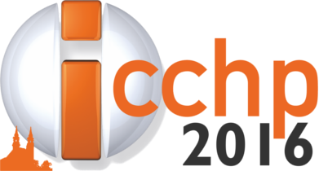
Memory Game and special HCI device in stroke therapy
Veronika Szucs, Mate Godar, Cecília Sik-Lanyi
UNIVERSITY OF PANNONIA, Hungary
Department of Electrical Engineering and Information Systems
Virtual Environments and Applied Multimedia Research Laboratory

Slide 2
PROJECt’S SCOPE
Stroke
Rehabilitation of movement coordination
Legacy methods
New devices, innovative technologies
In focus : Memory game – controlled with Microsoft Kinect sensor
Notes:
Nowadays the development of virtual reality-based application is one of the most dynamically growing area. These applications have a wide user base, more and more devices which are providing several kinds of user interactions and are available on the market. In the applications where the using of handheld devices are not necessary, the potential is that these can be used in educational, entertainment and rehabilitation applications.

Slide 3
REHABILITATION METHODS
Traditional rehabilitation
therapist, ergo therapist work with their patients – usually personally, not in group therapy the rehabilitation process takes very long time
Alternative rehabilitation opportunities Computer aided rehabilitation - apply the strengths and research results of IT in healthcare
Main goal: complete the therapy playfully
Notes:
In the rehabilitation, over the world, there are traditional and alternative opportunities.
The main goal of our project was to design and implement a serious-game application, which helps the older generation, stroke patients to complete the rehabilitation process or practice daily movements playfully.

Slide 4
MOTIVATIOn – NEW SOFTWER IDEA
Support stroke rehabilitation – is NOT a new idea
BUT: test and apply new technologies are very important
NEW hardware equipment:
These can be use without handhelding, for example: ASUS Xtion, Microsoft Kinect, LEAP Motion sensor etc.

Slide 5
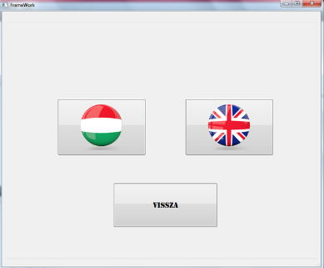
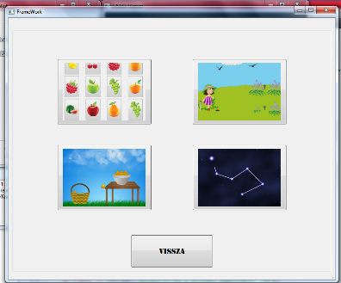
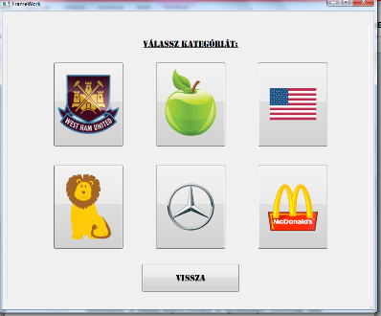
ABOUT THE SOFWARE
Memory Game - with Microsoft Kinect Control - easy to use Windows application - personality - gaming experience - step-by-step hardening levels - for any aging - especially for stroke patience, elderly people
Notes:
An easy to use application “Memory Game” and game framework were developed. The main importance of the game is the personality, gaming experience, use of modern HCI device (Kinect sensor). The users can play on step-by-step hardening levels. In this way this application is useful for any aging, useful for elderly people, for stroke patients. Only positive feedback was received during the tests. Despite the Kinect Sensor v1.0’s inaccuracy the game is easy to use and easy to control, the playing with this game is very enjoyable. In the future we plan to perform more tests with stroke patients, and plan to implement other difficulty levels.

Slide 6
scientific and practical impact
The scientific and practical impact or contributions to the field are of great importance and multiple:
to practise via gaming: more exciting, more incentive,
to practise in smaller group or individually: less frustration,
more motivational rehabilitations, trainings mean: decrease the duration of rehabilitation.
Thank you for your kind attention!
Contact: szucs@virt.uni-pannon.hu

