Slide 1
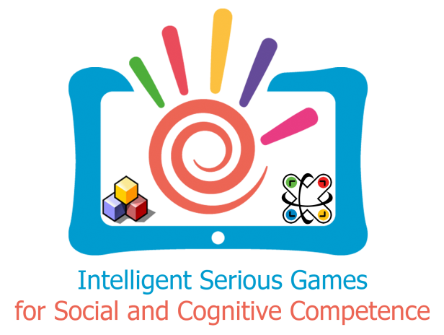
Target group questionnaire in the “ISG for Competence” project
Szilvia PAXIAN, Veronika SZÜCS, Shervin SHIRMOHHAMADY, Boris ABERSEK, Adrean LAZAROV, Karel VAN ISACKER, Cecilia SIK-LANYI

Slide 2
About ISG4Competence Project
ISG4Competence= Intelligent Serious Games for Social and Cognitive Competence
Ongoing project which was started in September 2015
The project is targeting children and youth with disabilities teaching them creativity and social competencies.
Additionally the project products can be used by intermediaries, special education centers, school teachers, special education trainers, training providers, universities (department of pedagogy, psychology, computer and instructional technology, assistive technology).

Slide 3
About ISG4Competence Project
Project consortium - multidisciplinary team for achieving the aims and objectives.
Each partner comes with unique expertise and experience either in the field of social competencies, creativity skills, digital competencies or interactive technologies and gaming, policy makers in school or education etc.
Project partners: universities, consulting enterprise, SME, NGO and mobile multimedia programming and development company from Belgium, Bulgaria, Hungary, Slovenia and Turkey.

Slide 4
Students with learning difficulties in Hungary
Most recently 83,634 students with learning difficulties in Hungary (according to data of the Hungarian Central Statistical Office, 2015)
Nearly 60% in primary schools, others in kindergartens, high schools or special schools
Approximately 63% integrated in mainstreaming schools
The others attend segregated schools/special schools

Slide 5
Experience with use of serious games
Our Department at the University of Pannonia has already developed a couple of serious games for different difficulties (dyslexia, dyscalculia, environmental awareness)
The feedback of the teachers and students were generally positive
Most of the children have shown decisive advancement in their skills, since the games are playful and children can easily use mobile devices

Slide 6
About the questionnaire
Data collected
Period: between 15th of January and 31st of April
Respondents reached: 94 people (74 online survey, 20 face-to-face interviews)
Target groups: Professionals involved in education, Families, Intermediaries, Training centre, Universities, Policy makers

Slide 7
Preliminary results in Hungary

Slide 8
Preliminary results in Hungary

Slide 9
Preliminary results in Hungary
Barriers

Slide 10
Preliminary results in Hungary

Slide 11
Reasons why existing pedagogical approaches/training materials fail in ensuring a successful acquisition of cognitive competencies
If the games are not used by the appropriate target group they might fail their developing aspect.
The students’ level is inhomogeneous
Only a few serious games and programs exist, which are available, mainly because of their price.
The current methods and materials were not especially designed for students with educational needs.
The family background is not really supportive, the amount of the curriculum might make some barriers, and the curriculum might also be boring.
Monotone, lack of ICT devices

Slide 12
Reasons why existing pedagogical approaches/training materials fail in ensuring a successful acquisition of cognitive competencies
Not flexible enough, it cannot be properly adapted to different needs, knowledge or experience
Lack of professionals, therapists are overwhelmed, lack of devices, anomalies in organizing
Inadequacy in the preparedness of teachers, content of curriculum
Lack of success in school, communicational and speech recognition problems, problems with concentration

Slide 13
Thank you for your attention!
Feel free to ask: Silvia Paxian
paxian@virt.uni-pannon.hu
Project website: www.isg4competence.com

